Slide 1

Customer Churn Analysis Using Python
Prepared by: Sukanya Das — Date: 27/01/2026. This project explores customer behavior, identifies churn patterns, and visualizes insights using Python libraries (Pandas, NumPy, Matplotlib, Seaborn) to inform retention strategies.

Slide 2

Executive Summary
This analysis examines a 7,043-row × 21-column public customer dataset to discover who churns and why. Key findings: month-to-month contracts and higher monthly charges are associated with higher churn; senior citizens churn more; longer-tenured customers churn less. Actionable recommendations focus on contract incentives, targeted pricing, senior engagement, and tenure rewards.

Slide 3
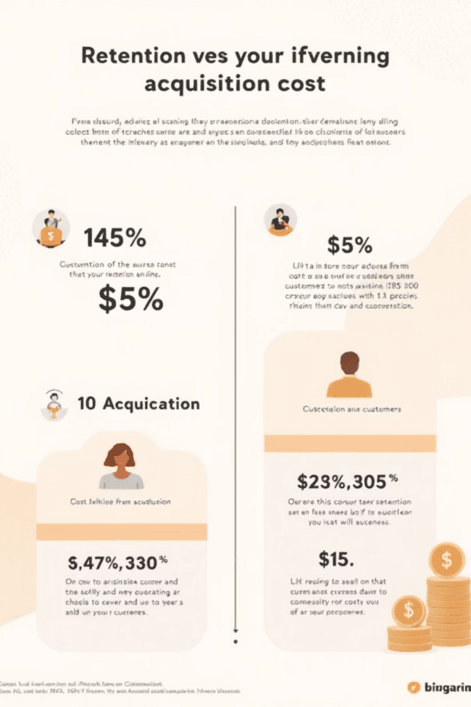
What Is Churn & Why It Matters
Churn (customer attrition) is the rate customers stop using a service over time. It’s critical for subscription businesses because retaining customers is far cheaper than acquiring new ones (acquisition can cost 5–7× more). Churn analysis stabilizes revenue, surfaces product or service issues, enables proactive interventions, and yields competitive advantage.

Slide 4
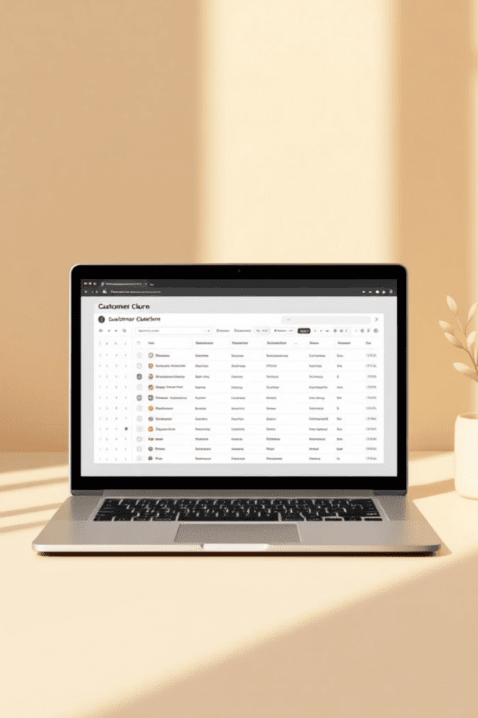
Dataset Overview
Source: Public open-source repository. Size: 7,043 rows × 21 columns. Key feature groups: Demographics (Gender, SeniorCitizen, Partners, Dependents); Service Subscriptions (Phone, MultipleLines, InternetService: DSL/Fiber optic, OnlineSecurity, DeviceProtection, TechSupport, StreamingTV/Movies); Billing & Account (Tenure, Contract, PaperlessBilling, PaymentMethod, MonthlyCharges, TotalCharges). Target label: Churn (Yes/No).

Slide 5

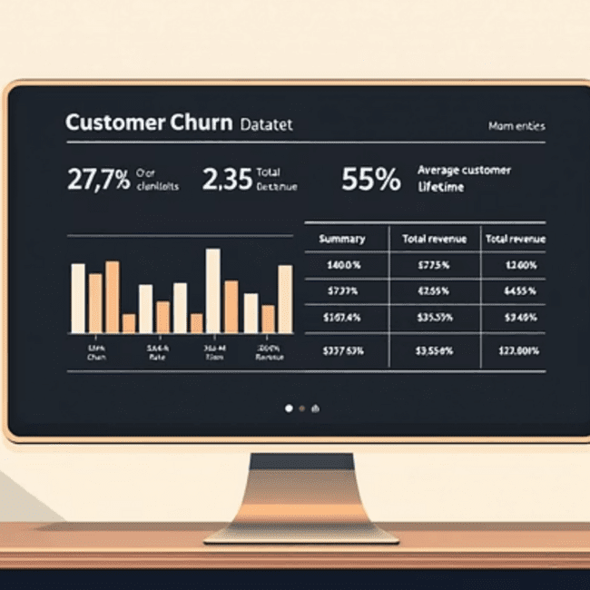

Methodology — Data Preparation
Steps performed: handled missing values, encoded categorical variables, and computed basic statistics (mean, median, mode). Preprocessing ensured numeric readiness for EDA and downstream modeling. The dataset was profiled and cleaned before visualization.

Slide 6
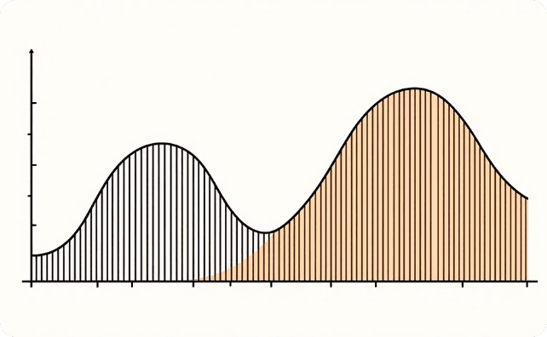
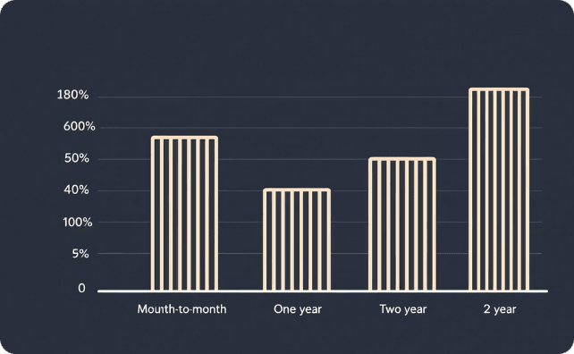
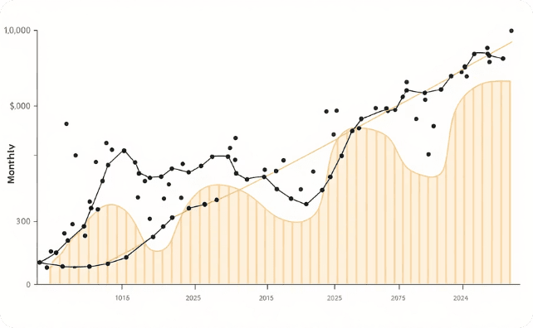
Exploratory Data Analysis (Key Visuals)
Explored distributions and relationships: churn vs non‑churn, churn by contract type, monthly charges vs churn, and tenure vs churn. Visualizations included multi-curve comparisons and individual distribution curves to highlight patterns across segments.
Overall Distribution
Contract Type
Monthly Charges
All-curves comparison reveals separation between churned and retained customers across several features.
Month-to-month customers show the highest churn; longer contracts show lower churn.
Higher monthly charges correlate with greater likelihood to churn.

Slide 7
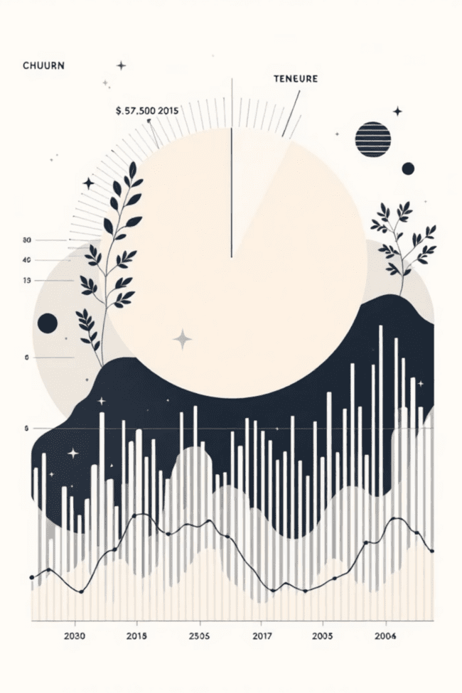
Results & Core Insights
Contract Effects
Price Sensitivity
Tenure & Loyalty
Month-to-month contracts drive higher churn (~43%), while one‑year (~11%) and two‑year (~3%) contracts show much lower churn.
Churned customers have higher mean monthly charges (~$74) versus retained (~$61), indicating price sensitivity.
Average tenure: churned ≈ 18 months; retained ≈ 36 months. Longer tenure correlates with retention.
Demographics
Senior citizens churn at higher rates than younger customers—highlighting a need for targeted engagement.

Slide 8
Metrics — Quantitative Highlights
Key metrics computed from the dataset:
26.5%
18 mo
36 mo
$74
Churn Rate
Avg Tenure (Churned)
Avg Tenure (Retained)
Monthly Charges (Churned)
Example: 1,869 out of 7,043 customers churned → churn rate ≈ 26.5%.
Churned customers average ~18 months.
Retained customers average ~36 months.
Mean monthly for churned ≈ $74 vs retained ≈ $61.

Slide 9


Recommendations
Encourage Longer Contracts
Incentivize one- and two‑year contracts (discounts, bundled services) to reduce month-to-month churn.
Targeted Pricing
Offer discounts or personalized plans for customers with high monthly charges to reduce price-driven churn.
Senior Engagement
Provide tailored support and engagement programs for senior citizens to address higher churn in this group.
Tenure Rewards
Implement loyalty benefits and tenure-based rewards to increase retention among longer-term customers.

Slide 10


Conclusion & Next Steps
Python-based analysis revealed clear churn patterns: contract type, monthly charges, senior status, and tenure are key drivers. Use these insights to design targeted retention strategies. Suggested next steps: build predictive machine learning models, integrate external data (feedback, surveys), and deploy interactive dashboards (Power BI, Tableau, or Dash) for ongoing monitoring.
THEME: #D3C5B6
PALETTE: #F2EBDF, #DECEBB
References
Pandas, NumPy, Matplotlib, Seaborn. THANK YOU

